Slide 1

Quantifying Pressing in Professional Football using Tracking Data
Master Thesis
Student: Shameek Khaled Egok
Program: MSc in Data Science - Kolding
Supervisor: Prof. Tariq Yousef

Slide 2
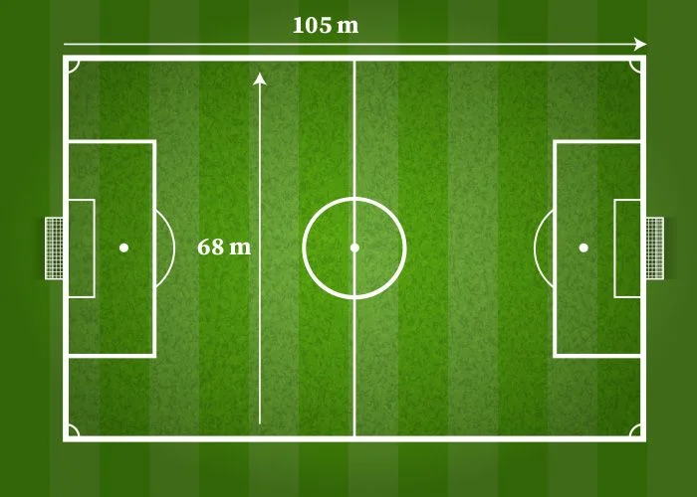
Motivation
Modern tracking systems generate millions of positional observations.
Raw positional data do not directly describe tactical behaviour.
High pressing is a continuous, context-dependent phenomenon.
This motivates a framework capable of transforming raw data into interpretable behavioural analytics.
Notes:
Recent advances in optical tracking technology have made large volumes of spatiotemporal football data available. While these datasets capture player and ball positions at high frequency, they do not directly describe tactical behaviours. Instead, tactical concepts such as pressing must be inferred from movement patterns, spatial relationships and game context. High pressing is particularly challenging because it is continuous, coordinated and highly dependent on possession state. This motivated the development of a framework capable of transforming raw tracking and event data into interpretable behavioural analytics.

Slide 3
Research Goal and Contributions
Research Goal
Develop a context-aware framework capable of detecting and evaluating settled high-pressing behaviour as continuous pressing sequences using synchronized tracking and event data.
Contributions
Integrated Data Representation
Context Construction
Sequence-based Detection
Outcome Evaluation
Notes:
The overall goal of this thesis was to develop a context-aware framework capable of detecting and evaluating settled high pressing from synchronized tracking and event data. To achieve this, the project was structured around four main contributions. First, integrating multiple heterogeneous data sources into a common analytical representation. Second, constructing contextual match states that are not explicitly available in the raw data, such as possession and valid pressing contexts. Third, modelling pressing as temporally connected sequences rather than isolated moments. Finally, evaluating those sequences through outcome classification and an interpretable scoring framework.

Slide 4
Data Sources
Tracking Data Player and ball positions 25 Hz Continuous spatiotemporal observations | Event Data Passes Shots Fouls Stoppages
Metadata Teams Periods Attacking Direction | Video Footage Qualitative validation Manual inspection
Notes:
The framework combines four complementary sources of information. The tracking data provide continuous player and ball positions at 25 frames per second and form the primary analytical input. Event data supply contextual information such as passes, shots and stoppages. Metadata provide information including attacking direction and match periods, while video footage is used for qualitative validation of detected pressing sequences. Together, these sources provide the foundation for the sequence-based pressing analysis framework.

Slide 5
Analytical Challenges
Heterogeneous Data Sources
  Tracking, event, metadata, and video originate from different systems.
Missing Tactical Context
  Possession, ball carrier, and pressing behaviour are not explicitly represented.
Continuous Behaviour
  Pressing develops across multiple players, passes, and movement phases.
Ambiguous Boundaries
  The start and end of a pressing sequence are rarely clearly defined.
Notes:
Although the dataset is rich, analysing pressing is not straightforward. First, the information comes from multiple heterogeneous sources that need to be combined. Second, the raw data contain positions but not the tactical concepts required for analysis, such as possession or pressing. Third, pressing is inherently continuous and develops over time rather than at isolated moments. Finally, there is no obvious point at which a pressing sequence begins or ends. These challenges motivated the design of the analytical framework that I'll present next.

Slide 6
Sequence-Based Pressing Analysis Framework
Raw Football Data
Data Integration
Context Construction
Behaviour Detection
Sequence Modelling
Outcome Evaluation
Notes:
To address the analytical challenges discussed on the previous slide, I developed a Sequence-Based Pressing Analysis Framework. The framework transforms raw football data into interpretable pressing sequences through a series of analytical stages. It begins with raw tracking, event, and metadata, which are integrated into a common analytical representation. Contextual information such as possession and valid pressing states is then constructed before any pressing analysis takes place. Once the match context has been established, the framework detects individual pressing behaviour, aggregates it into continuous pressing sequences, and finally evaluates each sequence according to its tactical outcome. The following part of the presentation examines each of these stages in more detail.

Slide 7
Data Integration
Problem
Tracking and event data
• Recorded independently
• Different timestamps
• Different formats
Integration Pipeline
Synchronization
Cleaning
Standardization
Notes:
The first stage of the framework is data integration. Although the tracking and event datasets describe the same football match, they originate from independent recording systems and therefore cannot be analysed together directly. The framework first performs temporal synchronization, aligning event timestamps with tracking frames using the kickoff as a global reference and local event matching for greater precision. The integrated data are then cleaned and standardized to ensure consistent coordinate representation and efficient frame-level processing. The result is a unified frame-level representation that forms the foundation for all subsequent stages of the framework.
Once the datasets have been integrated into a common representation, the next challenge is that they still do not explicitly contain the tactical concepts required for pressing analysis. The framework therefore constructs these contextual states before attempting to detect pressing behaviour.

Slide 8
Context Construction
Available Data (Tracking, events, metadata)
Context Construction
Possession Context (Ball Carrier, Team Possession, Anticipated Possession)
Spatial Context (Attacking Direction, Pressing Zone)
Ball State (Grounded / Aerial)
Valid Pressing Context
Notes:
After integrating the different data sources, the framework still cannot identify pressing directly because the raw data do not contain the tactical context required for behavioural analysis. At this stage, the framework begins constructing that context.
The first step is to establish the possession context. Using the positional tracking data, the framework identifies the active ball carrier and determines which team is in possession. During passing phases, where the ball may temporarily have no clear owner, an anticipated possession mechanism is used to maintain continuity until the receiving player gains control.
Next, the framework establishes the spatial context. This combines information from the match metadata, such as attacking direction, with the predefined pressing zone developed earlier in the framework. Together, these determine whether play is occurring in an area where settled high pressing is tactically meaningful.
The framework also evaluates the ball state. Grounded possession and aerial situations represent fundamentally different tactical contexts. Since the focus of this thesis is settled high pressing, aerial balls and other unstable situations are excluded from further analysis.
Finally, these contextual components are combined to determine whether the current frame represents a valid pressing context. Only frames satisfying all contextual conditions are passed to the behavioural detection stage.
An important idea throughout this framework is that context is constructed rather than directly observed. While the datasets provide player positions, events, and metadata, the tactical concepts required for pressing analysis must first be inferred or assembled before meaningful behavioural analysis becomes possible.
An important idea throughout this framework is that context is constructed rather than directly observed.

Slide 9
Behaviour Detection
Pressing Run
Movement Intensity
Distance Closing
Temporal Persistence
Movement Direction
Notes:
Once a valid pressing context has been established, the framework evaluates the behaviour of each defender. Rather than relying on a single condition, pressing is identified through a combination of behavioural indicators. First, the defender must exhibit sufficient movement intensity, indicating an active attempt to press rather than ordinary positional movement. Second, the defender's movement must be directed towards the current ball carrier or anticipated receiver. Third, the defender must actively reduce the distance to the target. Finally, these behaviours must persist across multiple consecutive frames. Only when all of these conditions are satisfied is an individual pressing run detected.
No single indicator is sufficient to identify pressing on its own. Instead, the framework combines multiple behavioural cues to reduce false positives and better represent purposeful defensive actions.

Slide 10
Sequence Modelling (1/2)
Initialization
  Begins when the first valid pressing run is detected within a valid pressing context.
Continuation
  Maintained across passing phases and brief interruptions using grace logic.
Termination
  Ends when pressing is no longer sustained or the tactical context becomes invalid.
Notes:
Once individual pressing runs have been detected, the framework groups them into temporally continuous pressing sequences. Every sequence follows a simple lifecycle.
A sequence is initialized when the first valid pressing run occurs within a valid pressing context. From that point onwards, the framework attempts to preserve tactical continuity. Rather than terminating the sequence immediately when pressure briefly disappears, it allows normal passing phases and short interruptions through continuity mechanisms such as anticipated possession and grace periods.
Finally, the sequence is terminated when the surrounding tactical context is no longer valid. This may occur following a possession change, an aerial ball, progression beyond the pressing zone, or a prolonged absence of active pressure.
By modelling this complete lifecycle, the framework represents pressing as a continuous tactical process rather than a collection of independent moments.

Slide 11
Sequence Modelling (2/2)
Sequence Initiation
Sequence Termination
Pressing Run 1 | Continuity | Pressing Run 2 | Continuity | Pressing Run 3
Whole Sequence
Notes:
How are individual pressing runs transformed into meaningful pressing sequences?

Slide 12
Outcome Evaluation
Outcome Classification
Composite Press Score
Positive Outcomes
  Possession regain
  Forced clearance
  Forced backward/sideways play
Neutral Outcomes
  No meaningful tactical change
Negative Outcomes
  Press bypassed
  Fast progression
  Shot conceded
Composite Press Score
Outcome
Defender Proximity
Duration
Notes:
Outcome has the highest weighting.
Once a pressing sequence has been identified, the final stage of the framework is to evaluate its effectiveness. The framework first classifies each sequence according to its tactical outcome. Rather than considering only possession regains, it distinguishes between positive, neutral, and negative outcomes. Positive outcomes include situations such as regaining possession, forcing clearances, or restricting the opponent's progression. Conversely, unsuccessful sequences are those where the opposition successfully bypasses the press or creates dangerous attacking opportunities.
In addition to this categorical classification, each sequence is assigned a composite press score. This score combines the tactical outcome with behavioural characteristics such as sequence duration and defender-target proximity. However, tactical outcome is intentionally given the greatest influence, ensuring that the evaluation reflects the practical effectiveness of the press rather than simply its duration or intensity.
Having presented the complete analytical framework, I'll now show how it performed when applied to professional match data.

Slide 13
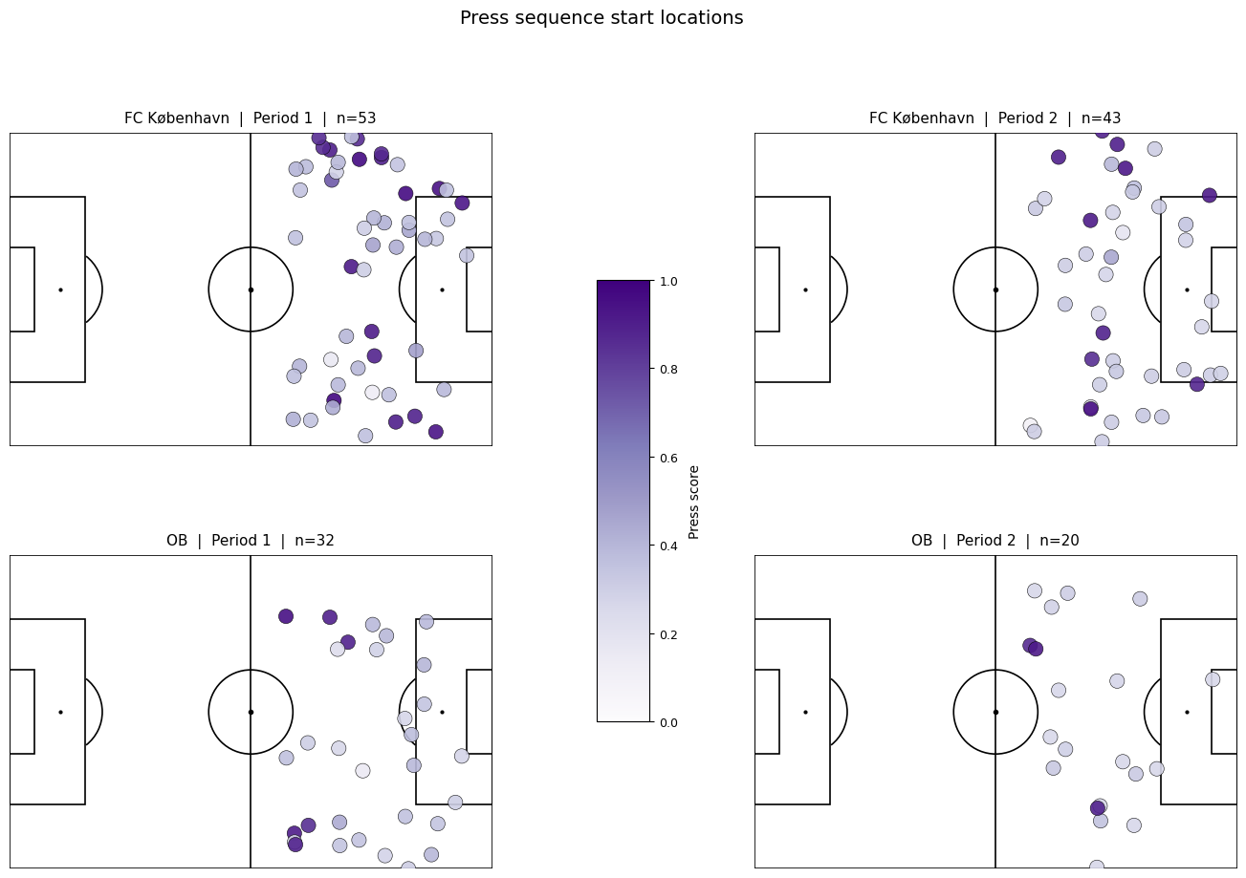
Spatial Evaluation
Concentrated pressing activity in advanced defensive areas
Spatial patterns align with expected high-pressing behaviour
Indicates context filtering is functioning as intended
Drop in intensity from the first half to the second mirrors realistic behaviour
Notes:
To evaluate the framework, I first examined the spatial distribution of detected pressing sequences. The heatmap shows the locations where pressing sequences were initiated across the analysed match. Most detections occur within advanced defensive areas, consistent with the intended definition of settled high pressing. This provides an initial indication that the contextual filtering and behavioural detection stages are identifying tactically plausible pressing situations.

Slide 14
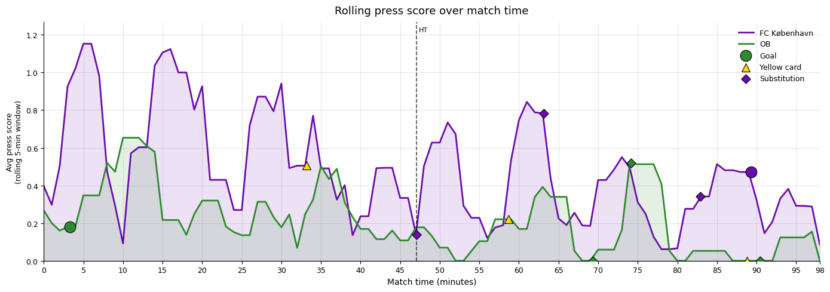
Temporal Evaluation
Pressing intensity varies throughout the match
Sustained periods of coordinated pressure become visible
Enables temporal comparison of defensive behaviour
Notes:
The rolling press score provides a temporal view of the framework's output. Rather than evaluating isolated events, it reveals how defensive pressure evolves throughout the match. Peaks correspond to sustained periods of successful pressing, while quieter periods reflect reduced defensive engagement.

Slide 15
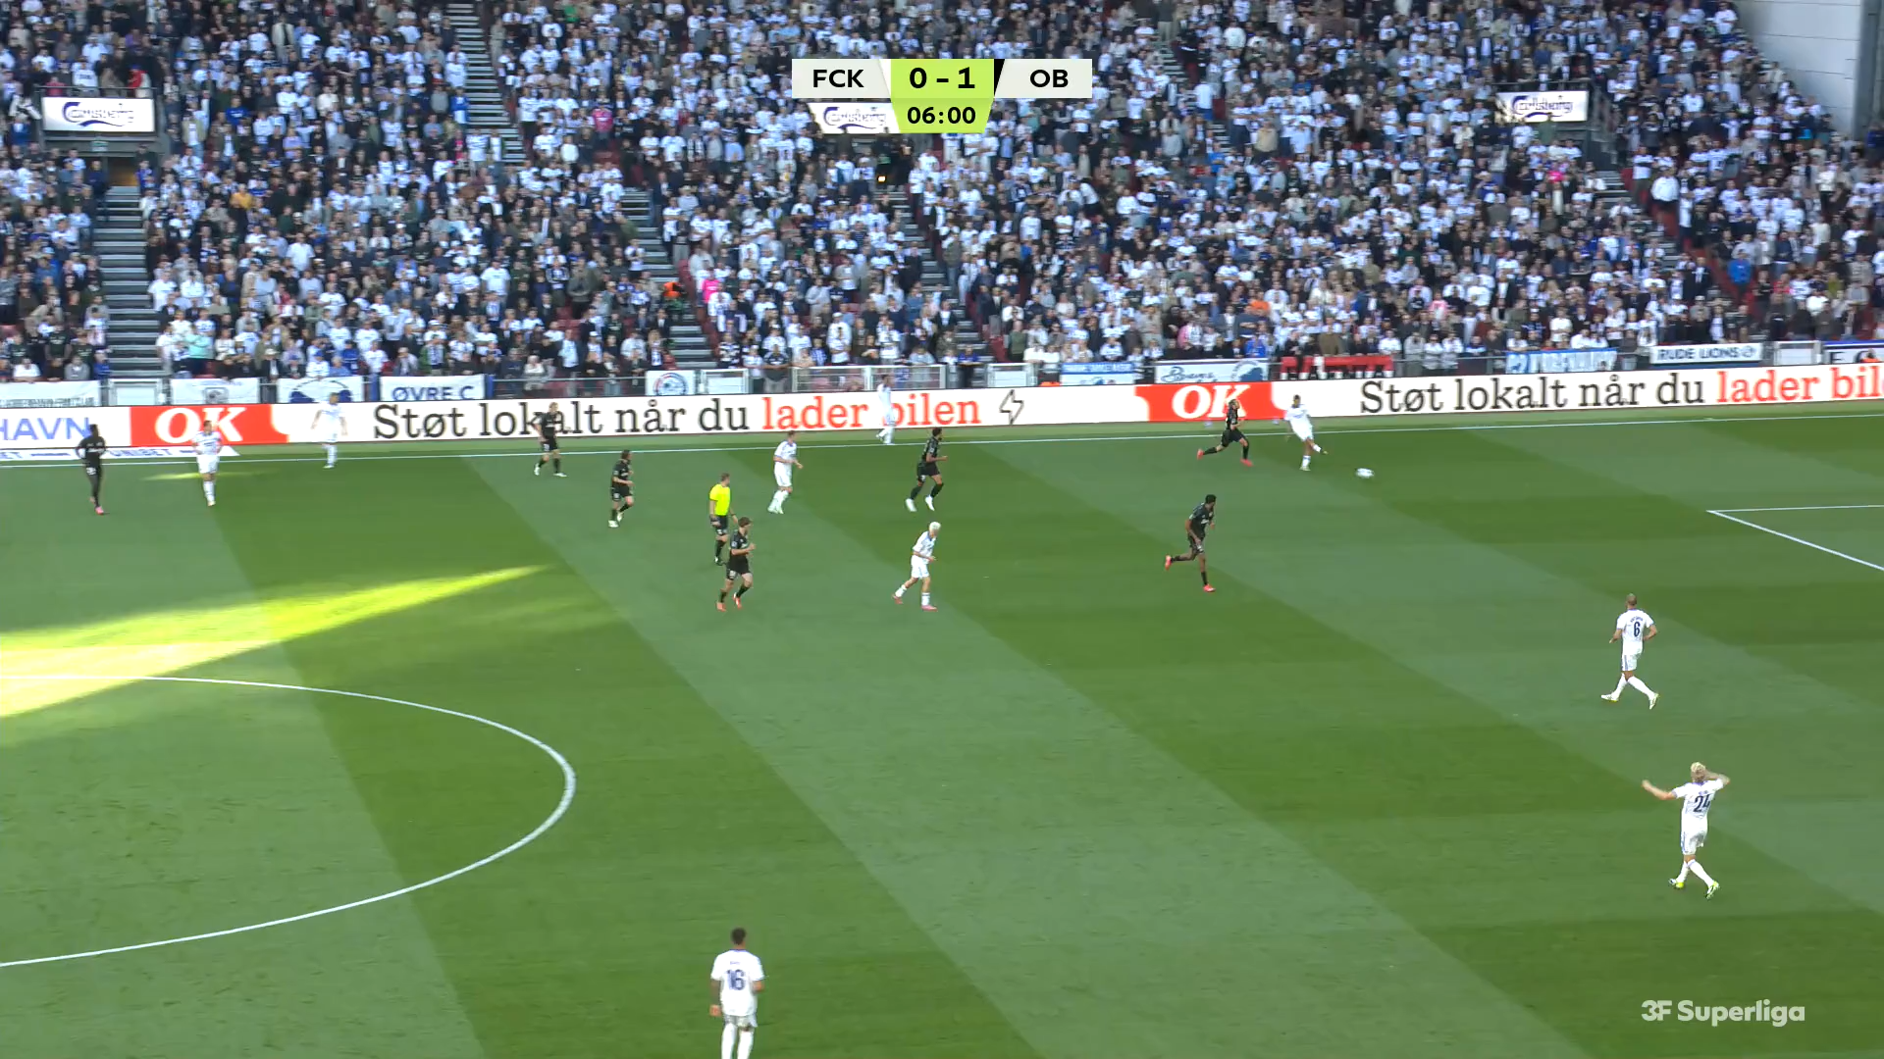
Qualitative Validation

Slide 16
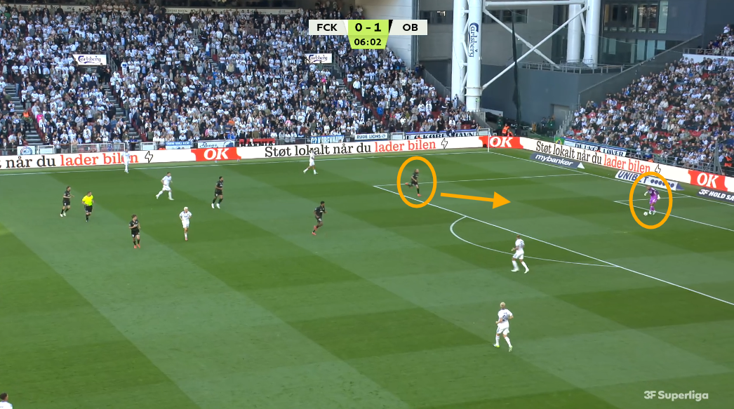
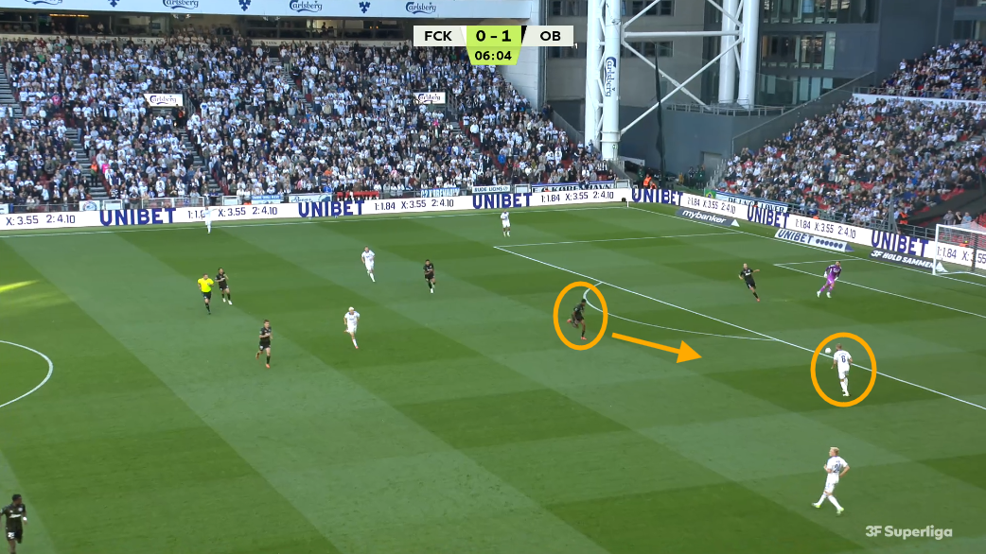
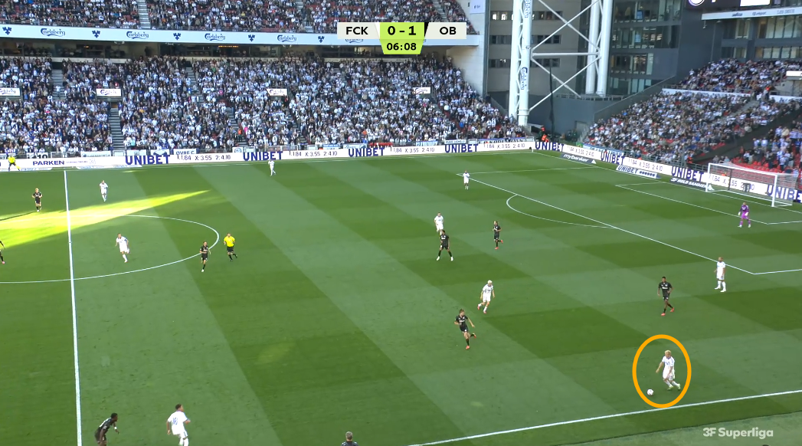
Sequence Breakdown
(a) Initial goalkeeper pressure
(b) Secondary pressure following pass transition
(c) Sequence termination after pressure release
Example of coherent pressing sequence detection
Notes:
Let's look at it in a little more detail.

Slide 17
Framework Strengths
Context-Aware Analysis
  Constructs tactical context before behavioural analysis
Sequence-Based Modelling
  Represents pressing as a continuous tactical process
Interpretable Evaluation
  Combines behavioural detection with tactical outcomes
Notes:
I believe the framework has three main strengths. First, it explicitly constructs tactical context before attempting behavioural analysis. This reduces ambiguity and allows pressing to be interpreted within meaningful game situations. Second, it models pressing as continuous sequences rather than isolated moments, better reflecting how pressing develops during real matches. Finally, the framework combines detection with evaluation through outcome classification and press scoring, allowing both the occurrence and effectiveness of pressing to be analysed.

Slide 18
Limitations
Sequence Ambiguity
  No clear boundaries between pressing phases.
Parameter Sensitivity
  Detection depends on thresholds, and tuning is computationally heavy.
Data Constraints
  Evaluation depends on the richness of tracking and event annotations.
Notes:
Although the framework performed well in the evaluated match, several limitations remain. Football pressing is inherently continuous, making sequence boundaries difficult to define precisely. The framework also relies on manually selected parameters, meaning different settings may influence the detected sequences. Finally, the richness of the analysis depends on the available tracking and event data. Additional contextual information, such as explicit pressing triggers, could further improve the framework.

Slide 19
Future Work
Adaptive Modelling
  Dynamic continuity instead of fixed thresholds
Richer Context
  Passing lanes
  Team shape
Larger Validation
  Multiple matches
  Different teams
  Expert annotations
Notes:
Several opportunities exist for extending the framework. Adaptive temporal modelling could replace fixed continuity thresholds. Additional contextual features, such as formation structure or passing-lane accessibility, may improve tactical interpretation. Finally, evaluating the framework across multiple teams and matches would provide a stronger assessment of its robustness and generalisability.

Slide 20
Conclusions
Framework
  Developed a context-aware sequence-based framework.
Results
  Produced tactically meaningful pressing sequences.
Contribution
  Demonstrated how raw tracking data can be transformed into interpretable behavioural analytics.
Notes:
Ultimately, this work demonstrates how raw spatiotemporal observations can be transformed into meaningful behavioural representations through context-aware sequence modelling.

Slide 21
Thank You

